Slide 1
The Economic Impact of the Covid-19 Pandemic on Chicago Restaurants
Group 5: Leila Zinstem a Moute, Josh Weidenaar,
Will Whalen, Michelle Goldberg

Slide 2
Project Objectives
To provide an analysis that can inform policy makers, business owners, and other interested parties of the ultimate impact of Covid-19 on restaurants in the city of Chicago and the neighborhoods in which they reside.
To shed light on how mobility and consumer expenditures were impacted by the prevalence of Covid-19 in Chicago neighborhoods
To uncover the many ways Covid-19 has upended the way of life for many Chicagoans and those most impacted
Data Sources
Food Service Industry Chicago Eater, Illinois Department of Commerce & Economic Opportunity BIG Recipient Data, Chicago Metropolitan Agency of Planning Neighborhood Profile Data
Health City of Chicago Open Data Portal, City of Chicago Department of Public Health
Supplemental
Google Mobility Data

Slide 3
Data Limitations
Chicago Covid Data was used at the case level only. Did not compare positivity rate, per capita rate or deaths.
Small sample size for restaurants
Data products based off of the ACS often follow a minimum two year lag. The retrieved data structure provided top five industry by employment for each chicago neighborhood, leaving neighborhoods without food service in the top five out of consideration for analysis that followed

Slide 4
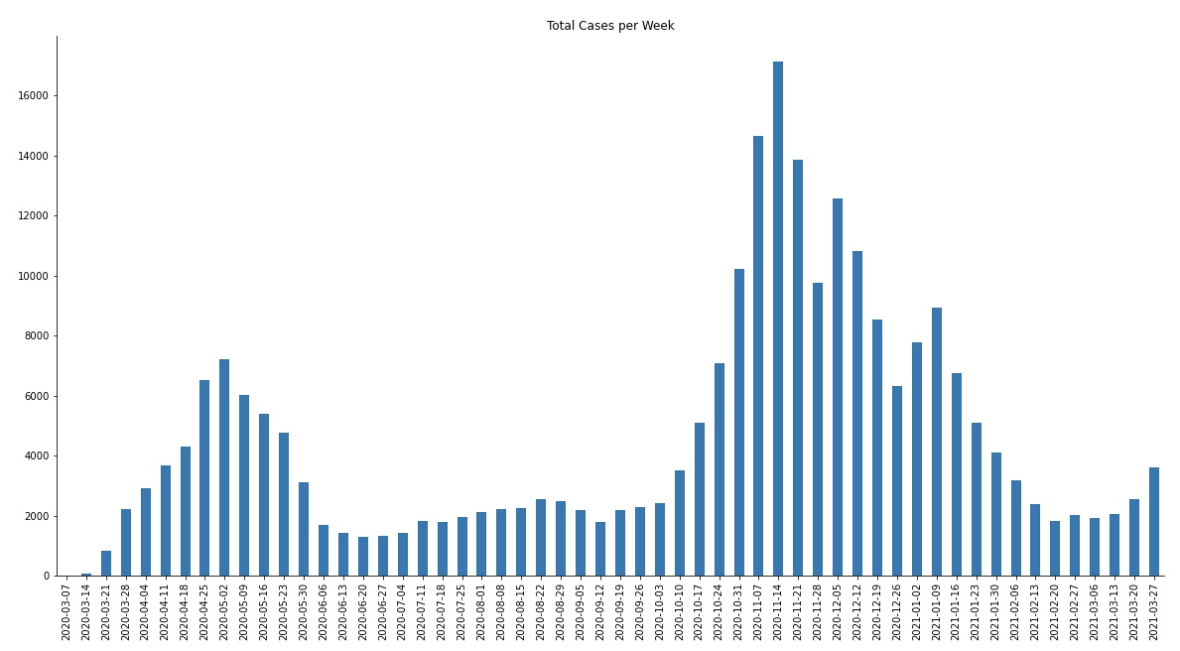
When Did Covid Hit Chicago the Hardest?
Largest Covid spike in Chicago: October 2020 through mid January 2021
Data Source: COVID-19 Cases, Tests, and Deaths by ZIP Code, City of Chicago, Chicago Data Portal

Slide 5
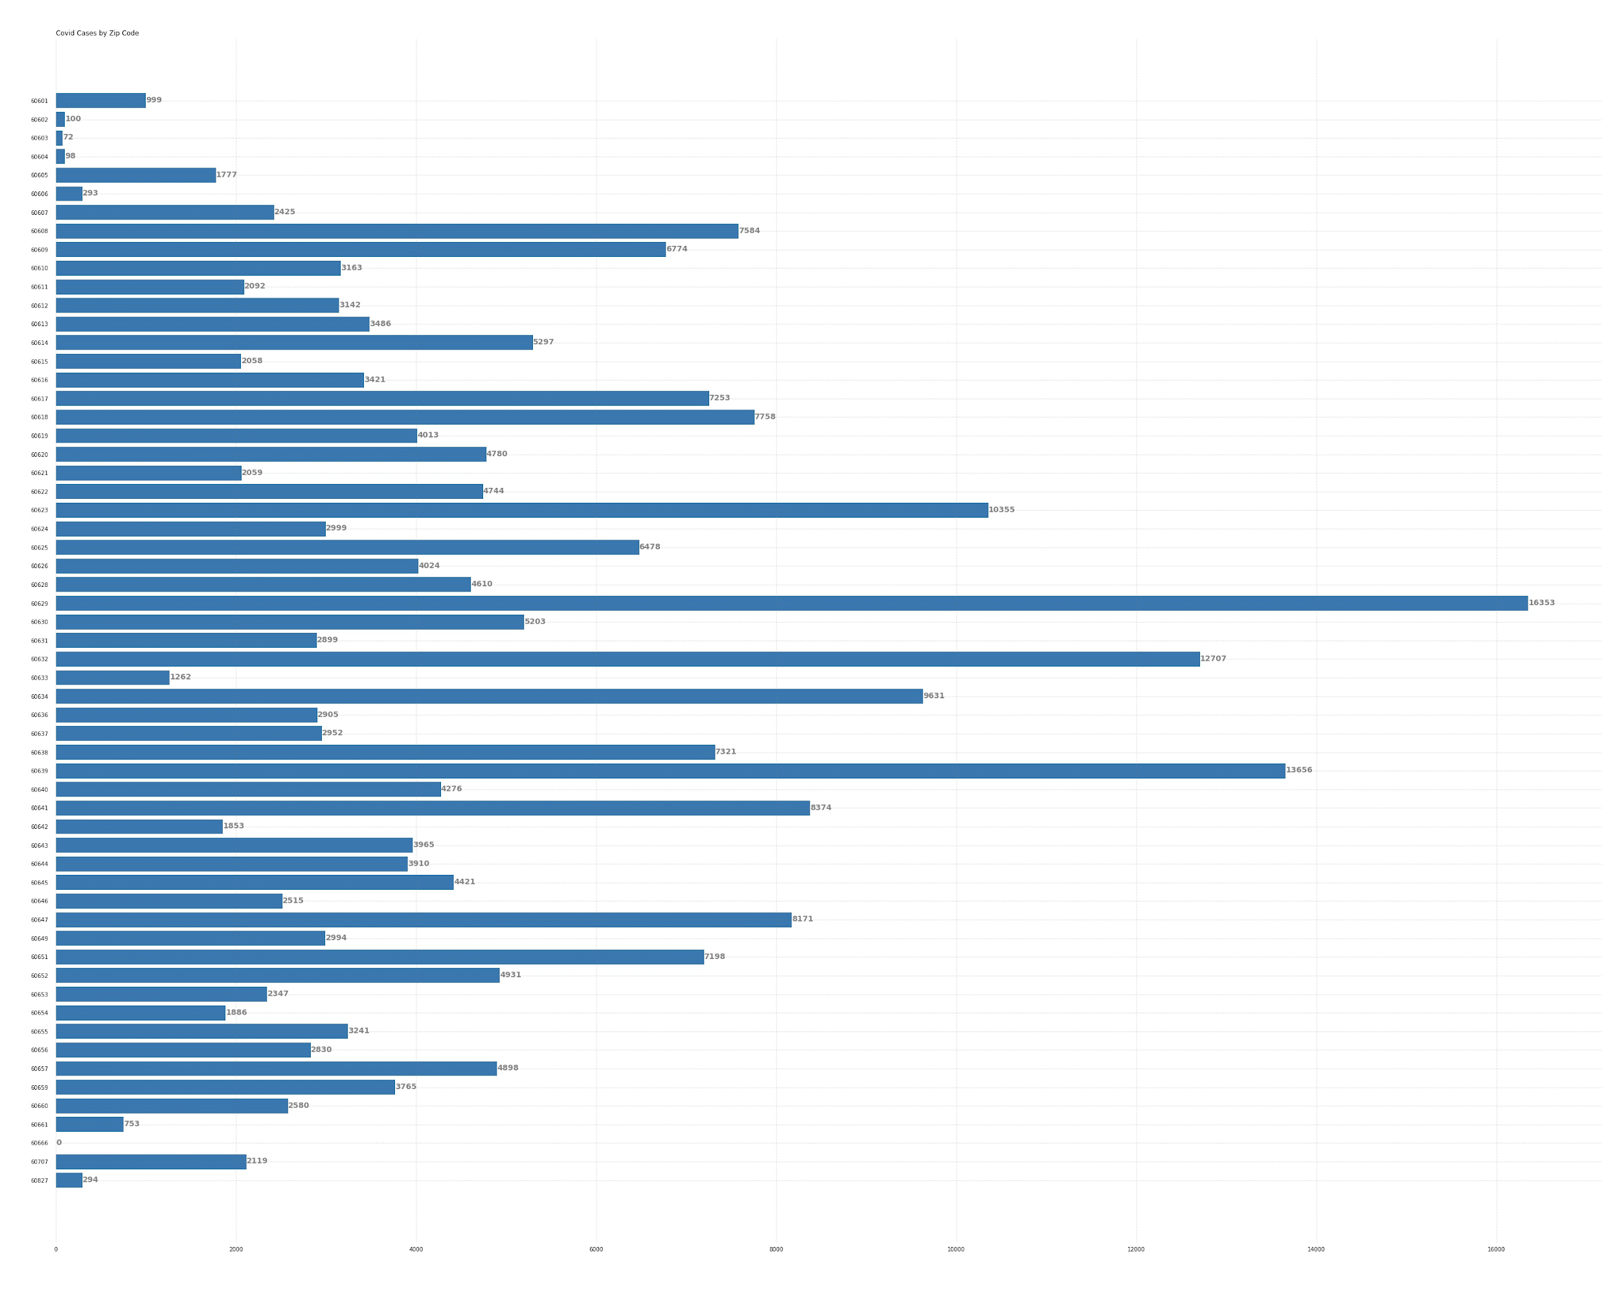
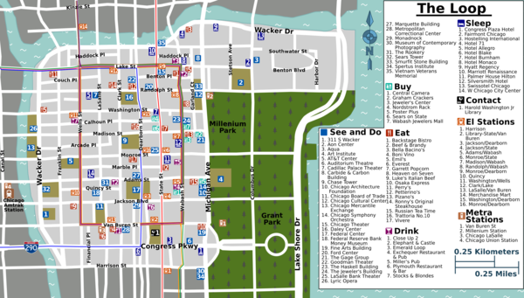
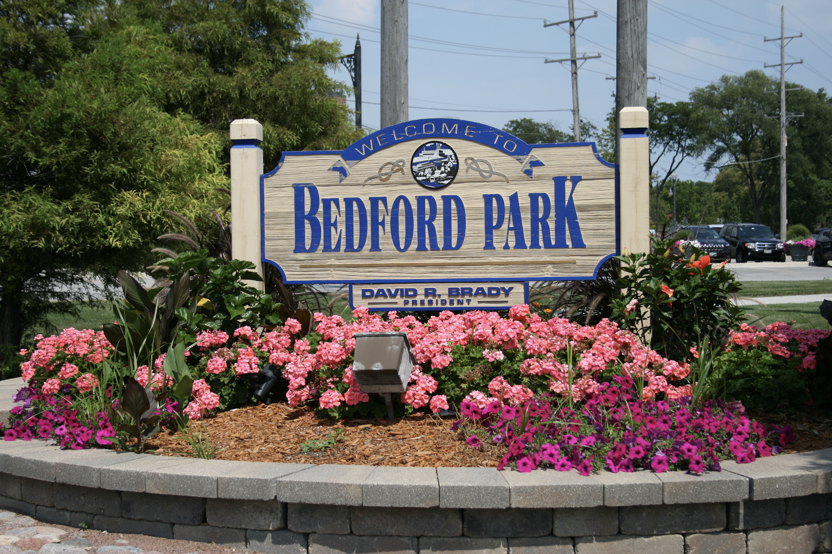

Where in Chicago Did Covid Hit the Hardest?
Zip Code 60602: 72 Covid Cases
60603: 100 Covid Cases
60604: 98 Covid Cases
Zip Code 60629: 16,353 Covid Cases
Zip Code 60666: 0 Covid Cases
Data Source: COVID-19 Cases, Tests, and Deaths by ZIP Code, City of Chicago, Chicago Data Portal

Slide 6
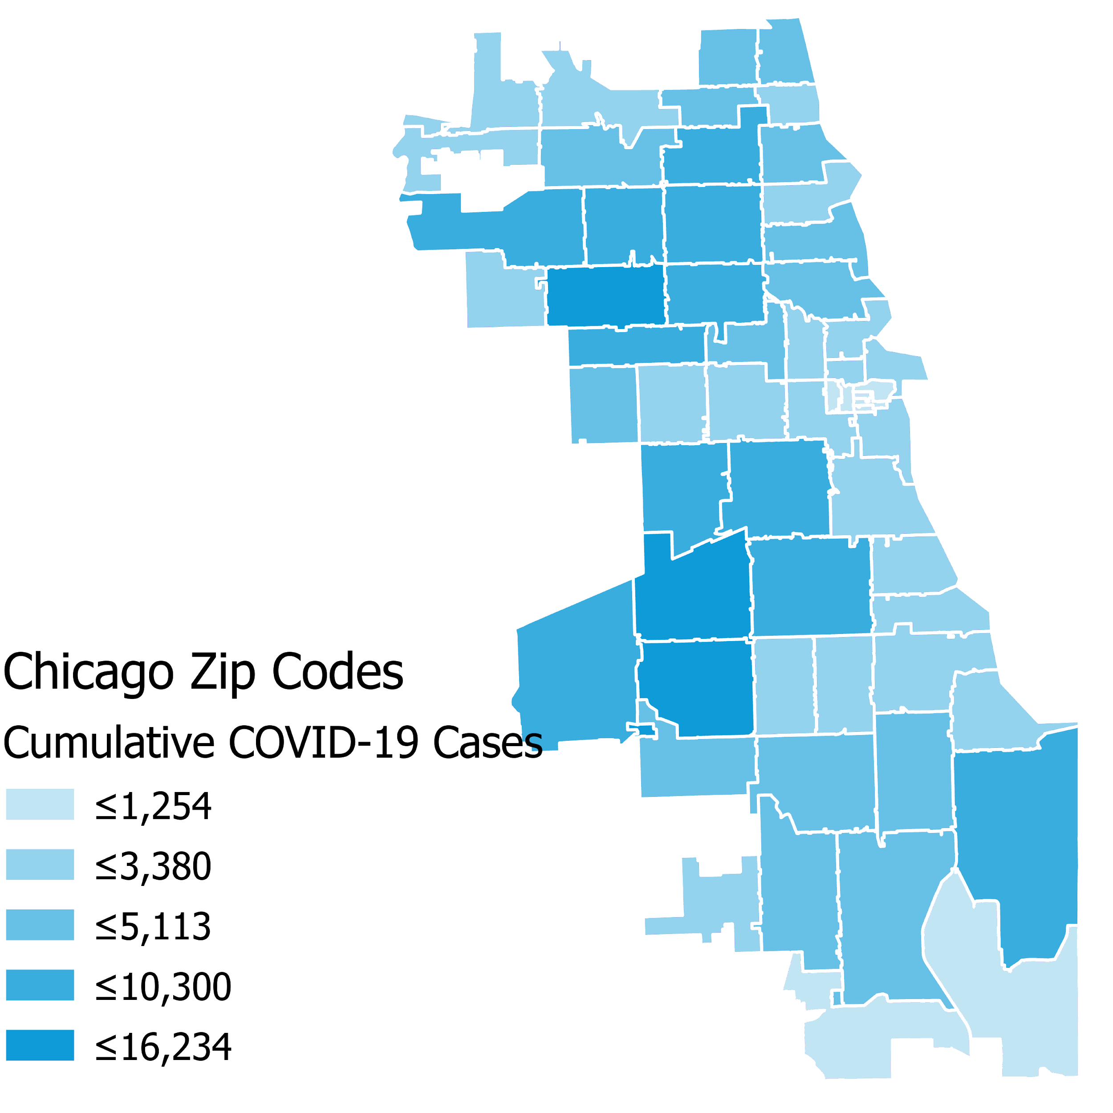
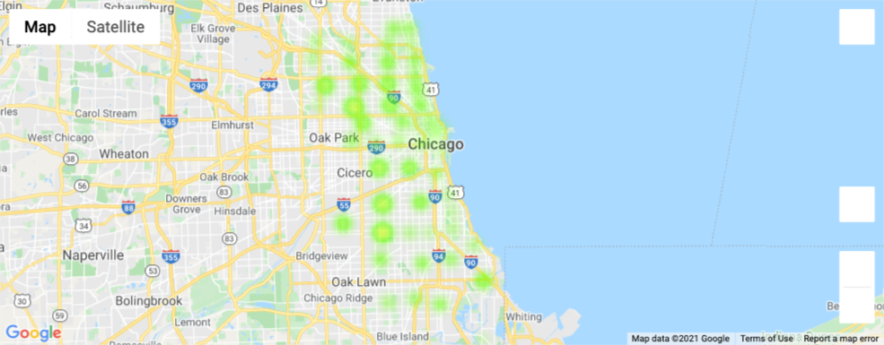
What Does This Look Like Geographically?
60639: Hermosa
60629: Bedford Park
Data Source: COVID-19 Cases, Tests, and Deaths by ZIP Code, City of Chicago, Chicago Data Portal

Slide 7
Illinois State Business Interruption Grants (BIG)
Launched in June 2020 using relief funds from the federal CARES Act
$636 million allocated to impacted businesses around the state
Largest state-sponsored economic relief package in the US
Intended to help cover working capital and operating expenses
Source: https://qctimes.com/news/local/govt-and-politics/business-interruption-grants-available-for-small-businesses-in-illinois/article_5f18320e-472c-52e7-a9fa-b01f3293a0fc.html
Notes:
Explain how BIG program was much needed for affected businesses, especially restaurants (expand on this in next slide). Give background on BIG program.

Slide 8
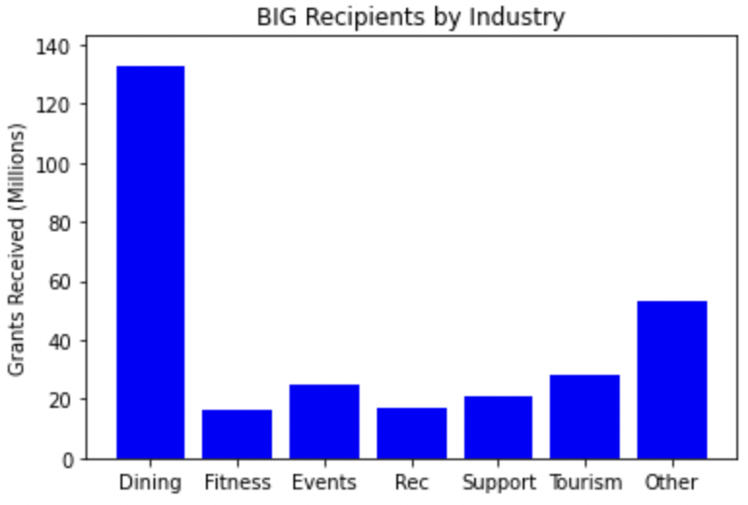
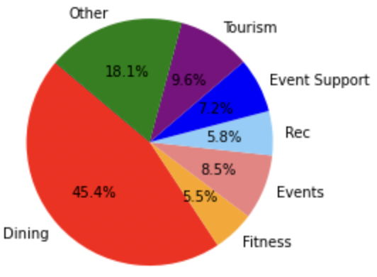
BIG Recipients by Industry
Source: https://www2.illinois.gov/dceo/SmallBizAssistance/Documents/BIG%20Detailed%20Data%201.8.21.pdf
Notes:
Explain/show how restaurants were the most affected businesses by covid

Slide 9
COVID-19’s Impact on Restaurants in Chicago
Data:
Chicago Eater: https://chicago.eater.com/2020/1/16/21067528/chicago-restaurant-bar-closures-2020
Google Mobility report: https://www.google.com/covid19/mobility/

Slide 10
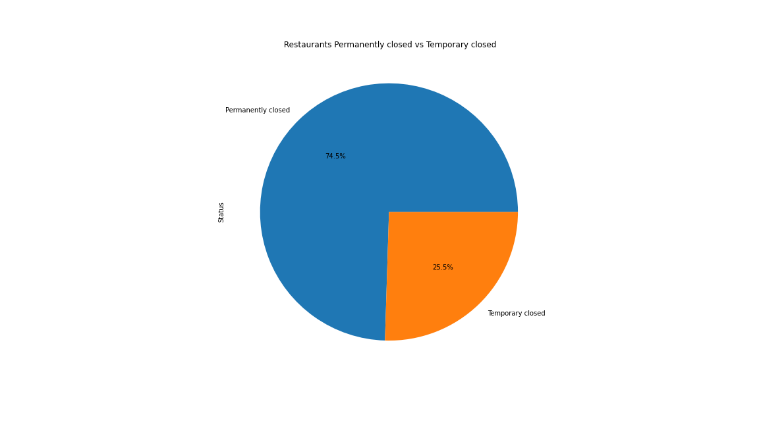

Slide 11
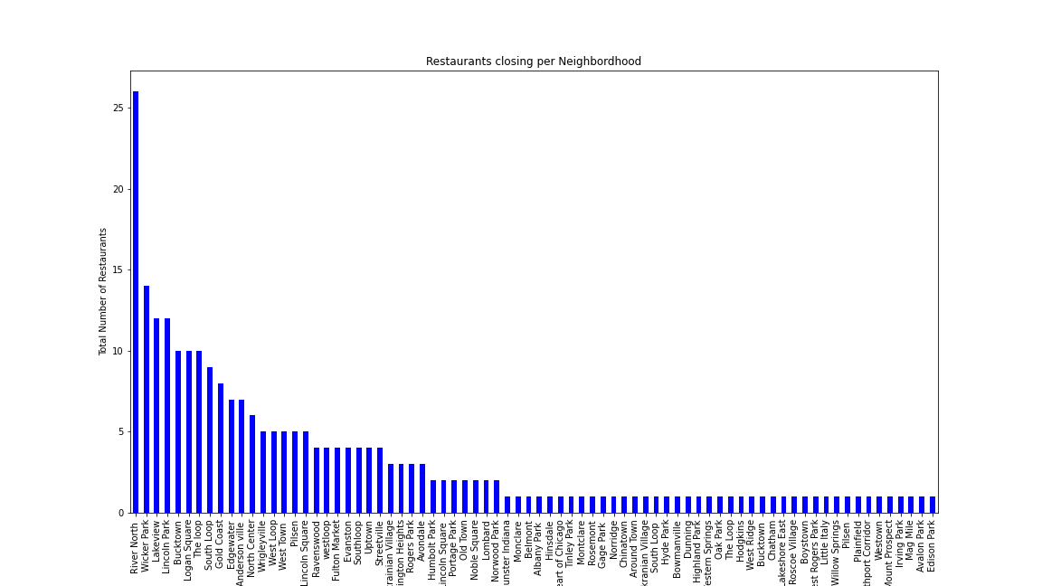

Slide 12
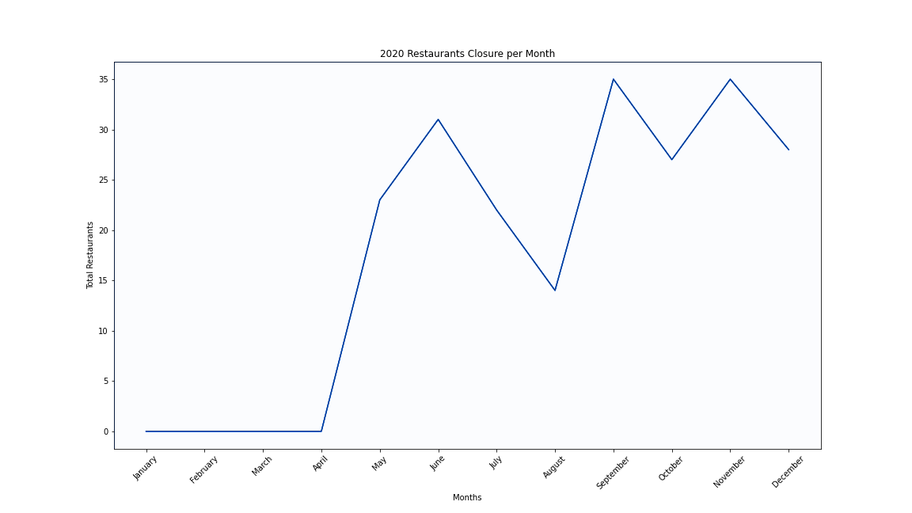

Slide 13
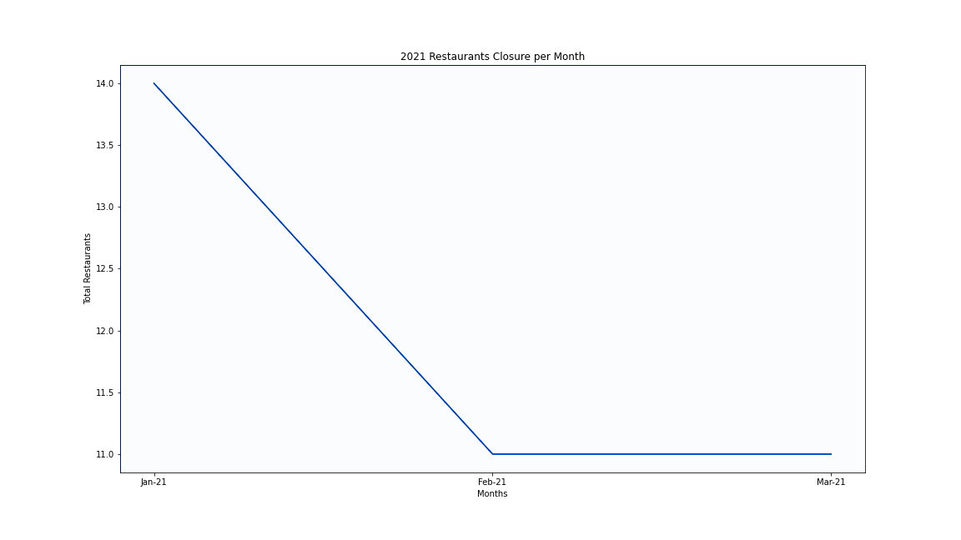

Slide 14
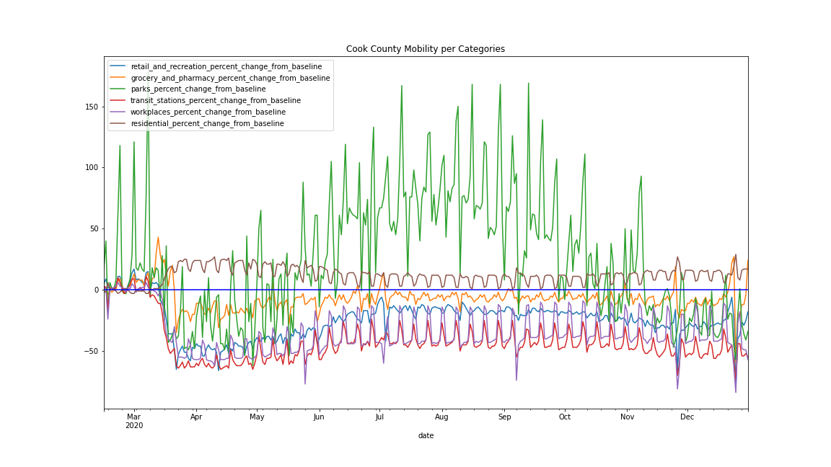

Slide 15
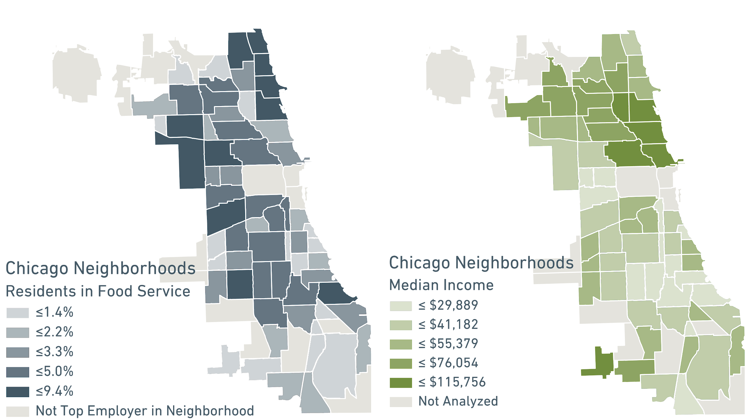

Slide 16
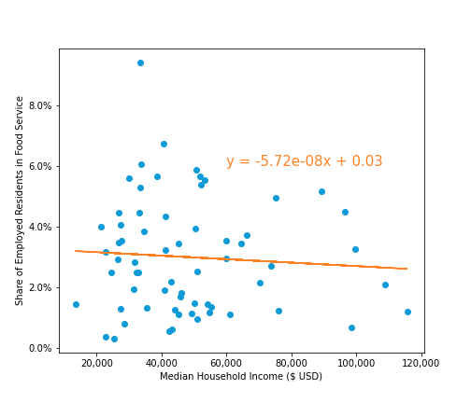
Chicago Neighborhood Employment Share and Income
Lakeview is home to the most food service workers 4.6K (5.2%)
Austin is home to the highest concentration of food service workers 9.4% (3.1K people)
Chicago neighborhoods with a greater density of food service workers may have a lower median household income
Trend may be further solidified if all Chicago neighborhoods were included in the analysis
Many factors beyond the scope of this analysis influence where Chicagoans live vs. work

Slide 17
Recap/Conclusion
Restaurants were the hardest hit businesses by the pandemic, necessitating a large influx of federal and state aid to stay afloat
There were more restaurants that closed permanently than temporarily
Restaurant closures occurred more frequently in neighborhoods with strong commercial corridors, but service workers are not as likely to live in those neighborhoods
The downturn experienced by restaurants in Chicago had a disproportionate impact on residents of lower income Chicago neighborhoods

